Slide 1
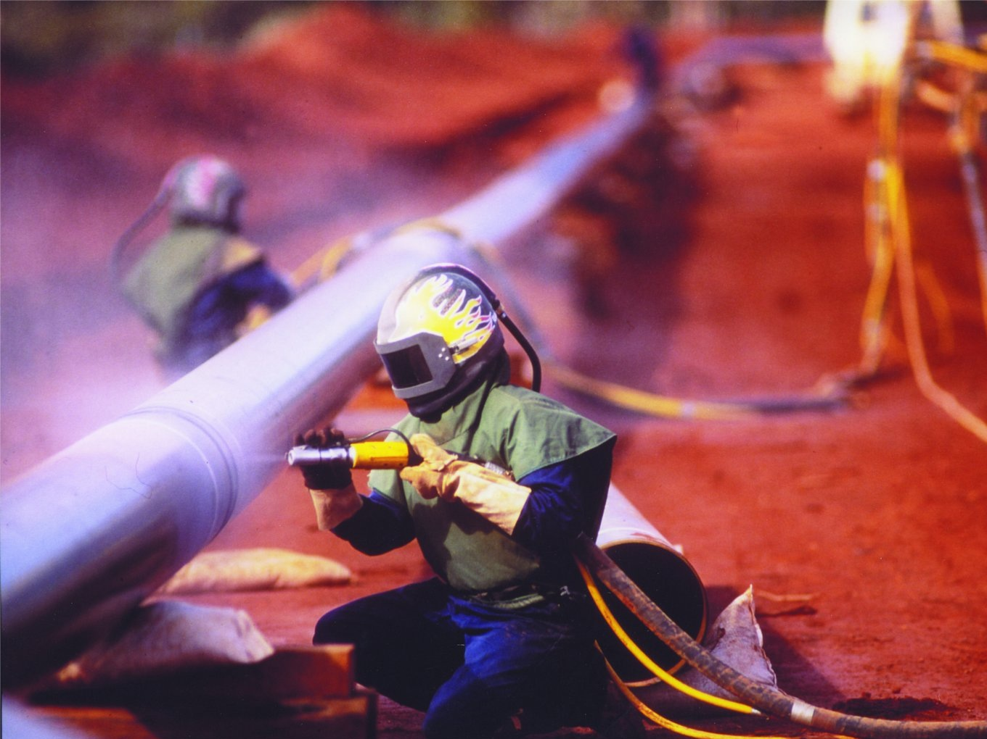
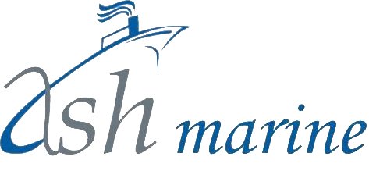
Thermal Spray Coatings

Slide 2
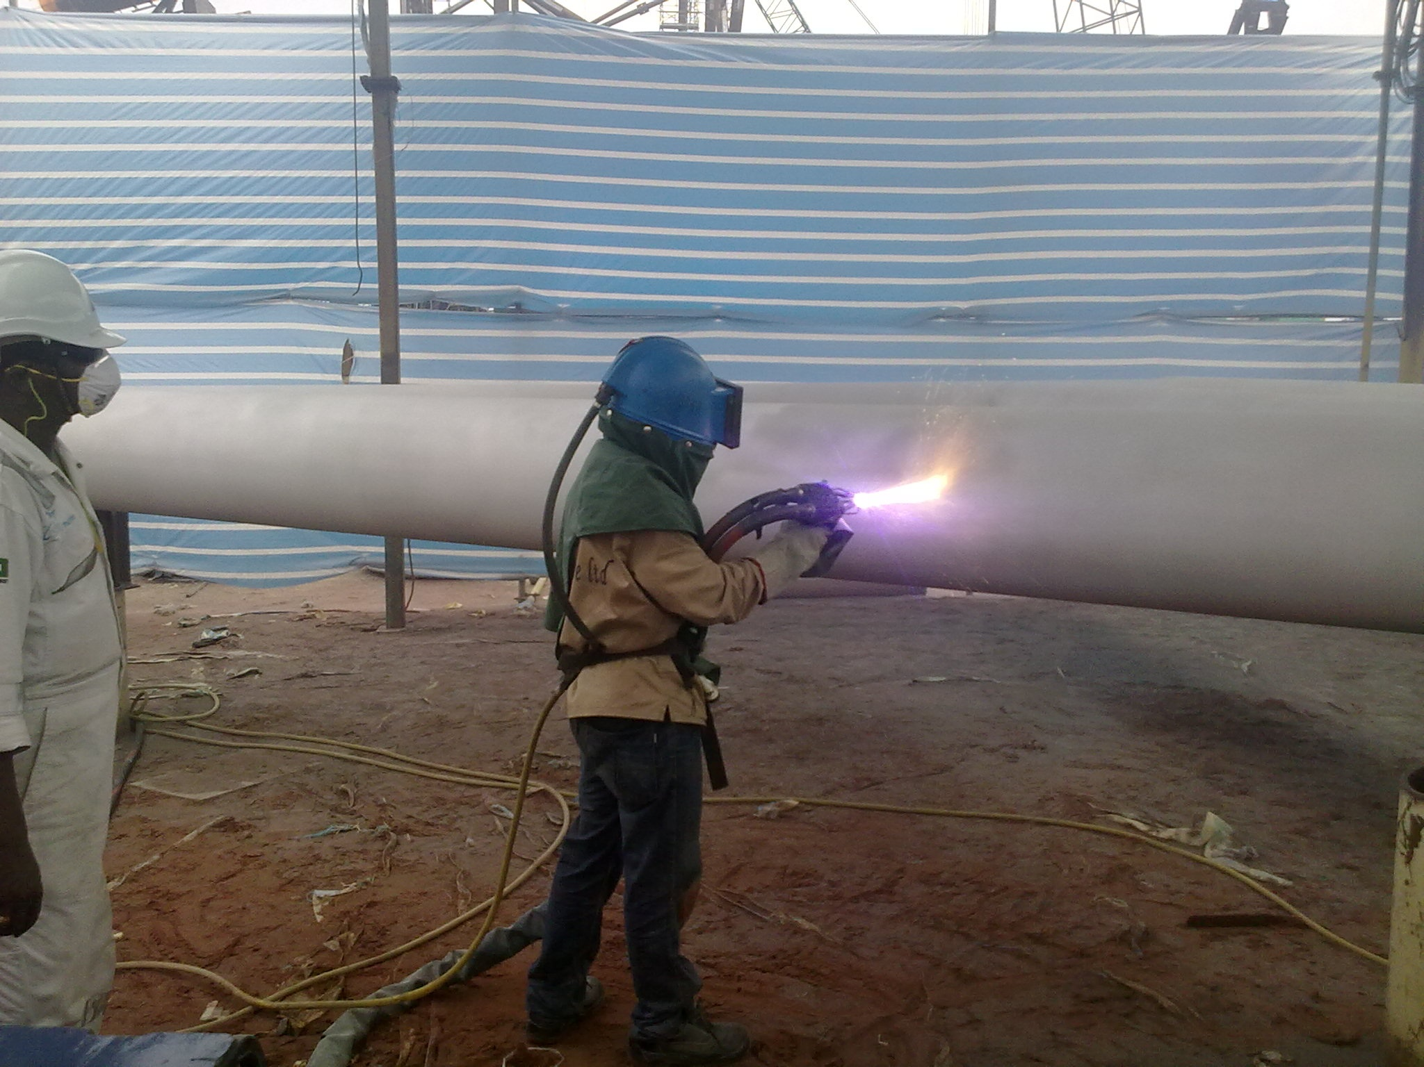

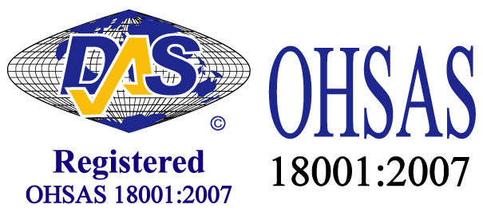
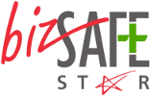


Comprehensive Solutions For Marine and Oil & Gas Corrosion Control
Ash Marine has been providing innovative, economical and high quality abrasive blasting, thermal metal spray and painting solutions to the maritime, petrochemical, downstream and upstream sectors for over a decade since its inception in 2006
Our core expertise is in abrasive blasting and thermal spray applications.
We have invested in our own research and development to continually identify new and improved blasting & coating processes to improve productivity and quality.
We are a company dedicated to the success of every customer and associate. Our aim is to delight our customers with complete satisfaction through competitive pricing, fast delivery, outstanding technical performance and superb reliability for all our services.

Slide 3
About US
Services:
Abrasive Blasting
Protective Coatings
Thermal Spray Application
Passive Fire Protection
Non-skid Coatings
Power Tooling
Coating Inspection Services
Specialists in Thermal Spray Coating (TSC)
Highly qualified and experienced multi-national workforce
50,000m² TSC applied; over 200,000m² of blasting and spray painting experience

Slide 4
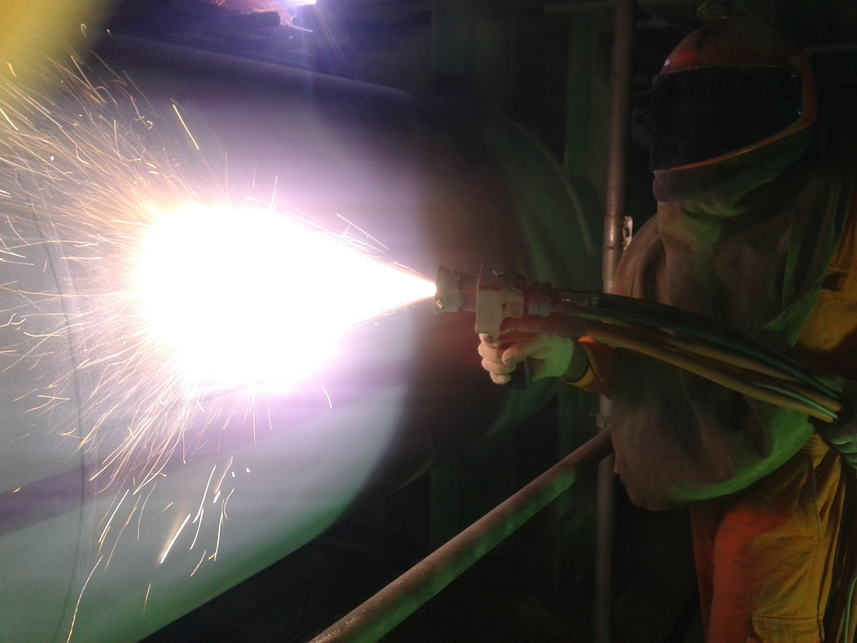
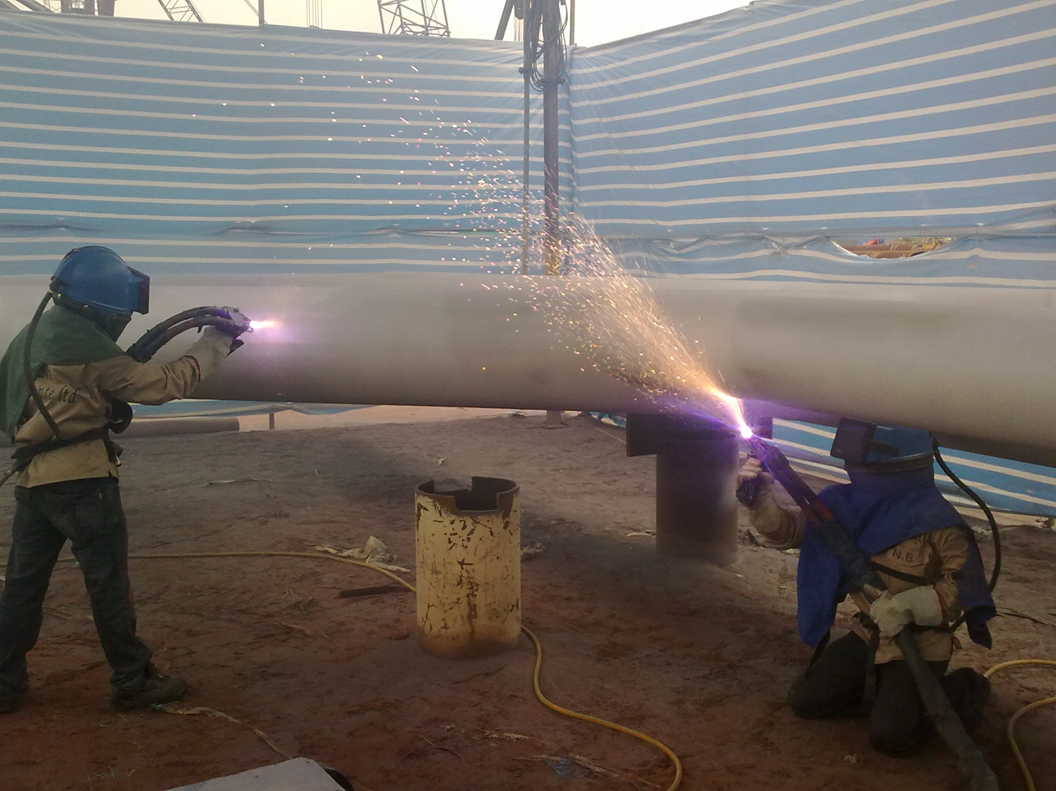
About US
Quality Certifications:
  ISO 9001:2008
  SSPC QP1
  SSPC QP6
Personnel- NACE ,SSPC certified
Safety Certification:
  OHSAS 18001:2007, BizSafe Star
Based in Malaysia and Singapore with services across Asia-Pacific
Multinational Clients:
Shell, Exxon Mobil, BP, Maersk, Petronas, L&T, SBM, Transocean, Keppel Shipyard, Jurong Shipyard, US Navy.....

Slide 5
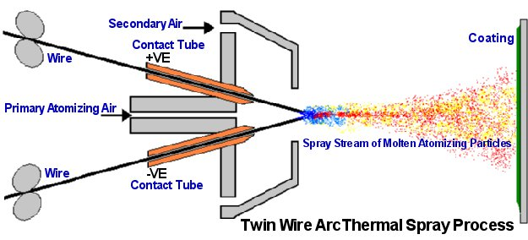
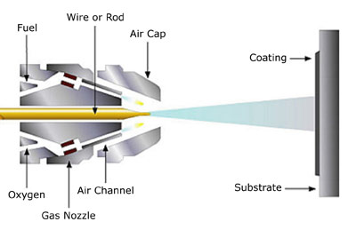
What is Thermal spray coating
Most preferred coating for long term corrosion protection of various steel structures
Process of spraying molten metals such as Aluminium at high velocity onto the surface of a structure
Molten particle forms both metallurgical and metallic bonding with substrate
Comparable to Hot Dip Galvanizing in performance
TSC facilitates a wide choice of coating materials such as Zinc, Aluminium, Bronze, Stainless Steel, Zinc Aluminium (85/15), Copper & Nickel
Other uses of TSC
  Provide base metal thickening & reclamation
  As a non-skid coating on walkways and deck
  As a hard protective layer against abrasion or erosion such as in caisson pipes

Slide 6
Advantages of Tsc
Advantages of TSC over conventional coatings:
  Superior Corrosion Protection
  Superior Adhesion & Cohesive Strength
  Greater Hardness
  Abrasion & Erosion Resistance
  Provides Cathodic Protection
  No curing or drying period. Ready to use after application.
  No hazardous VOC
  Wide Choice of Coating Materials
  Only solution recommended for CUI environment
  Maintenance-free coating life for more than 20 years even in C5 environment

Slide 7
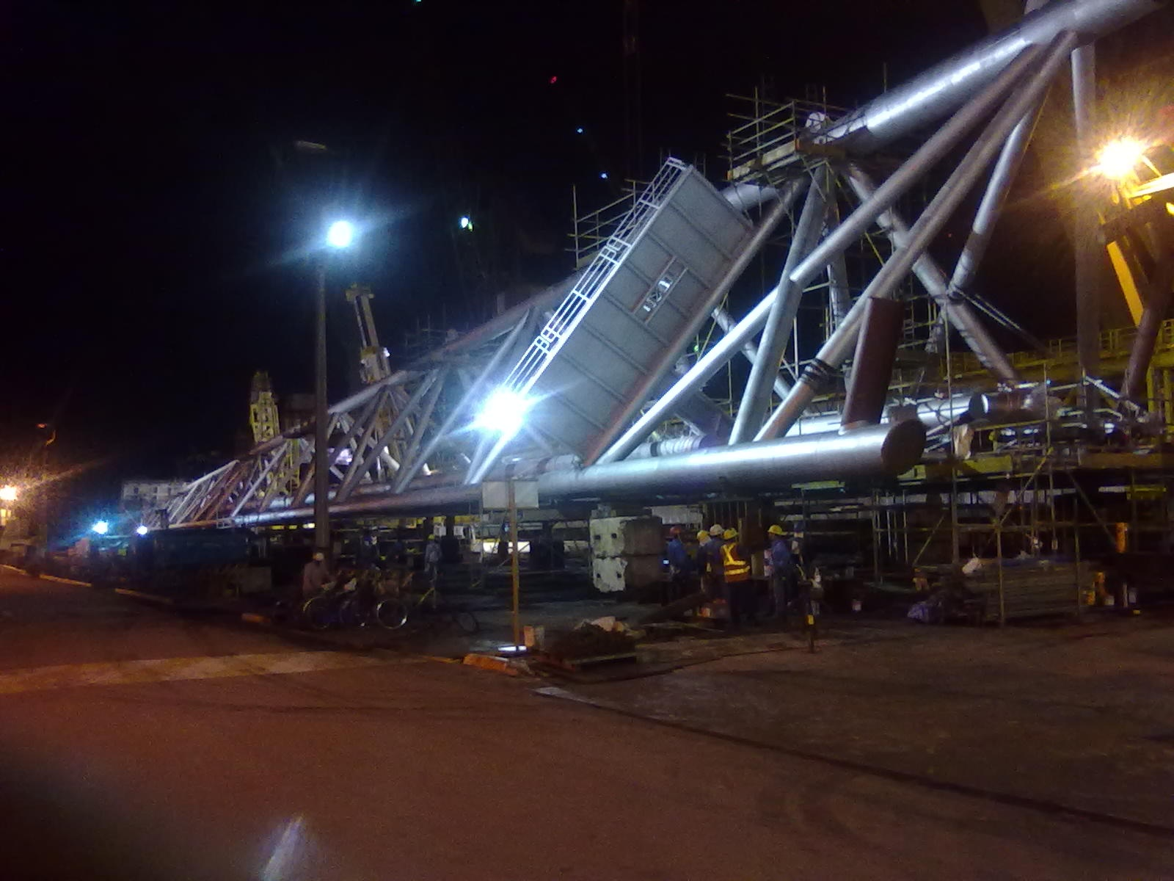
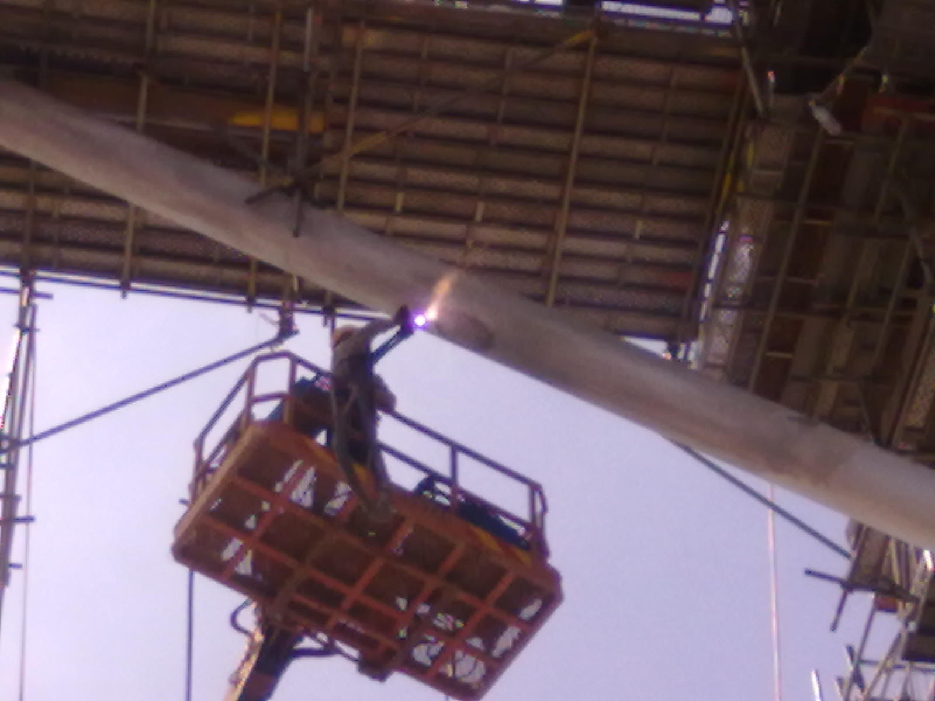
production CAPABILITIES
Average 80m² per machine at 250µm for each 8-hour shift
Round the clock operations if required
Automatic application if required
Ability to work in various environments such as
  Refineries with stringent safety regulations
  Cramped conditions with limited mobility on scaffold platforms
  Confined spaces such as tanks inside vessels
  Heights of more than 30m

Slide 8
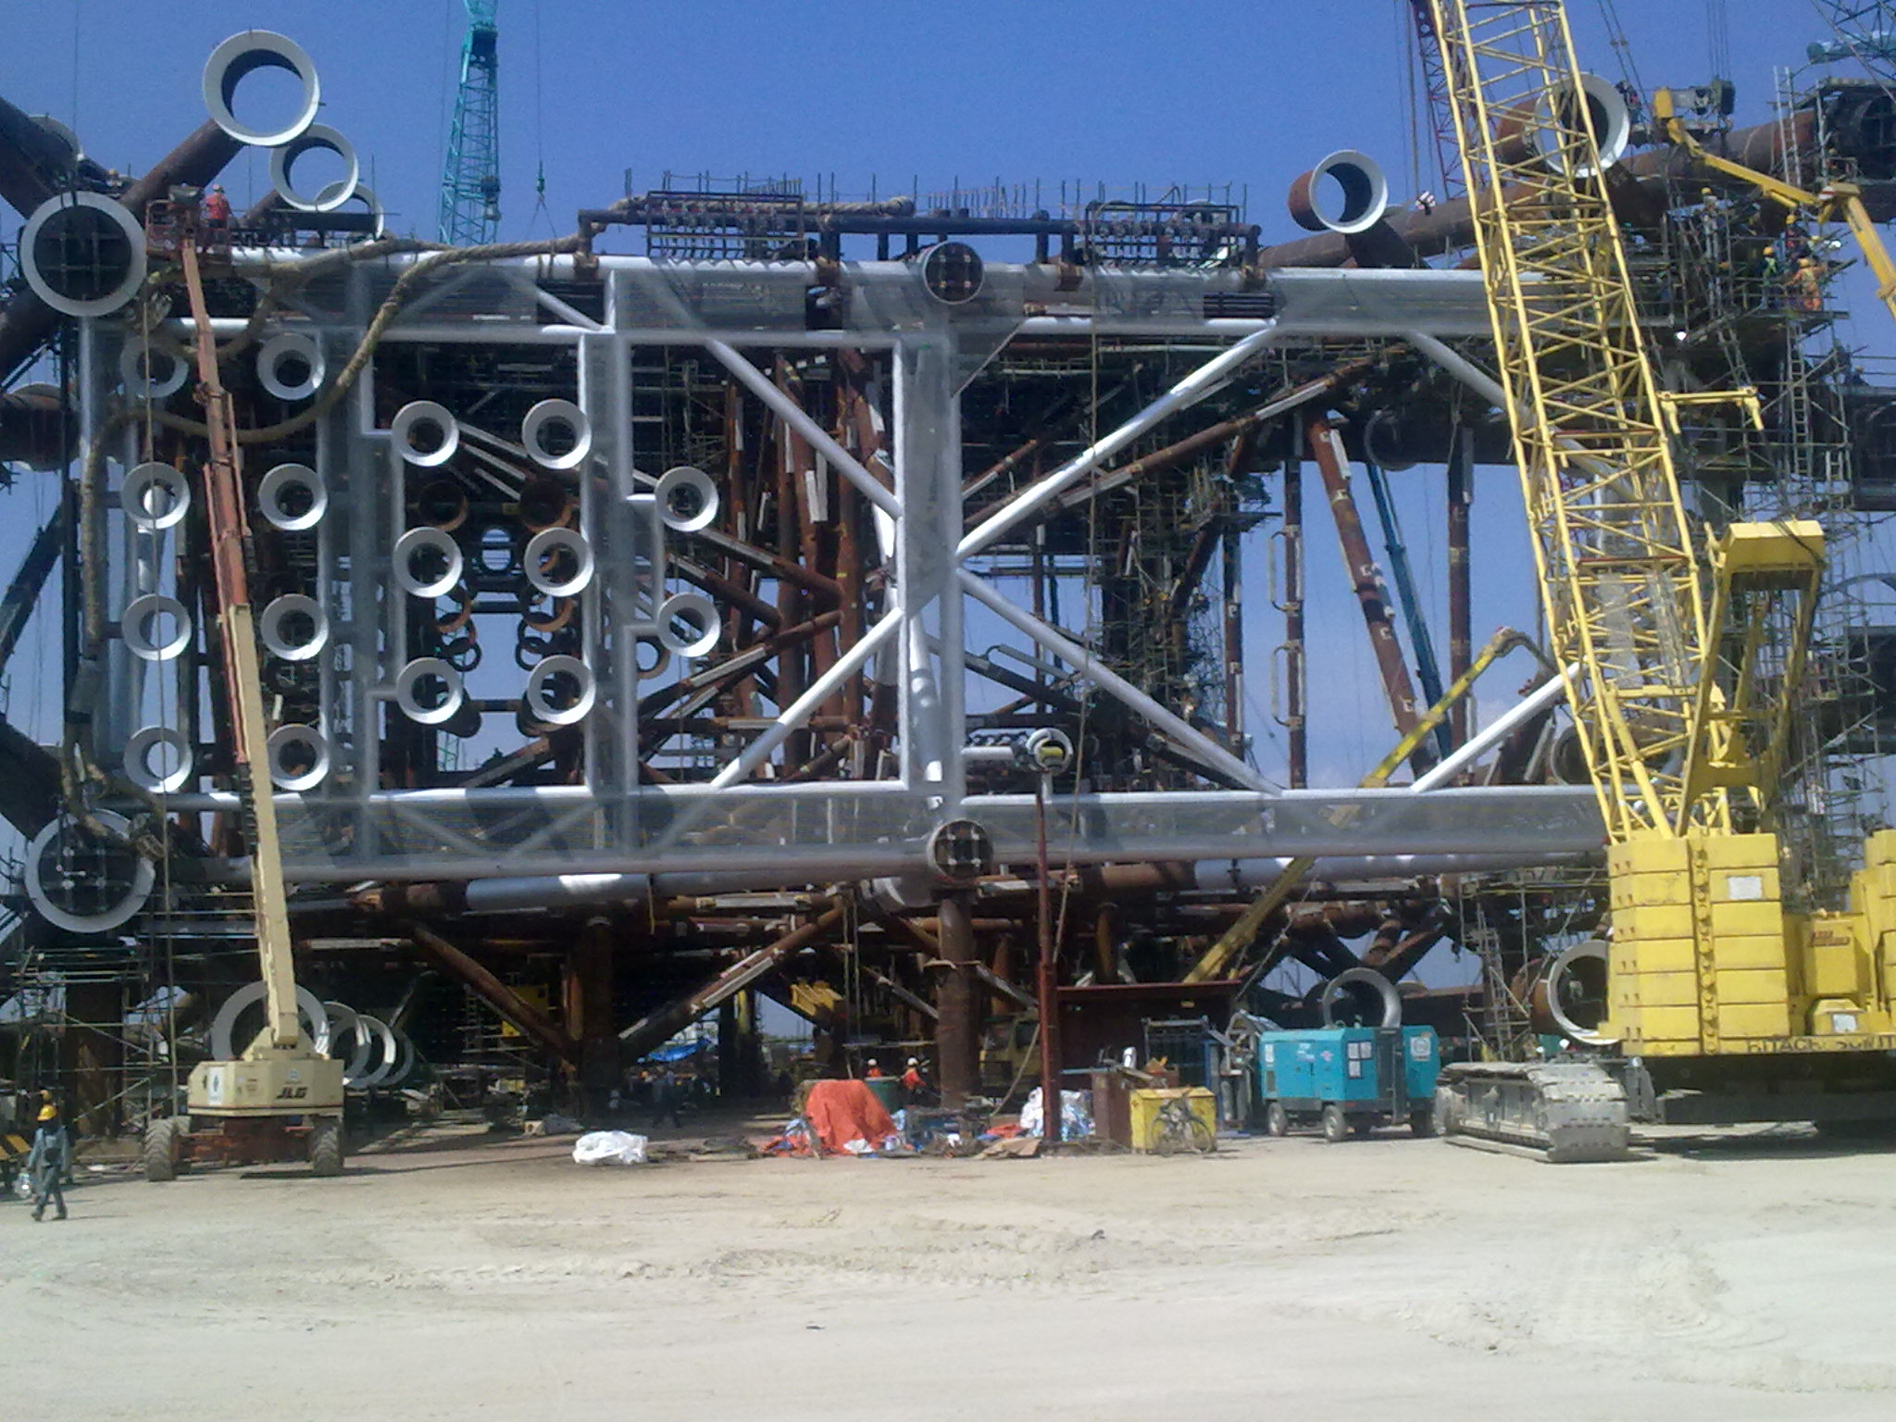
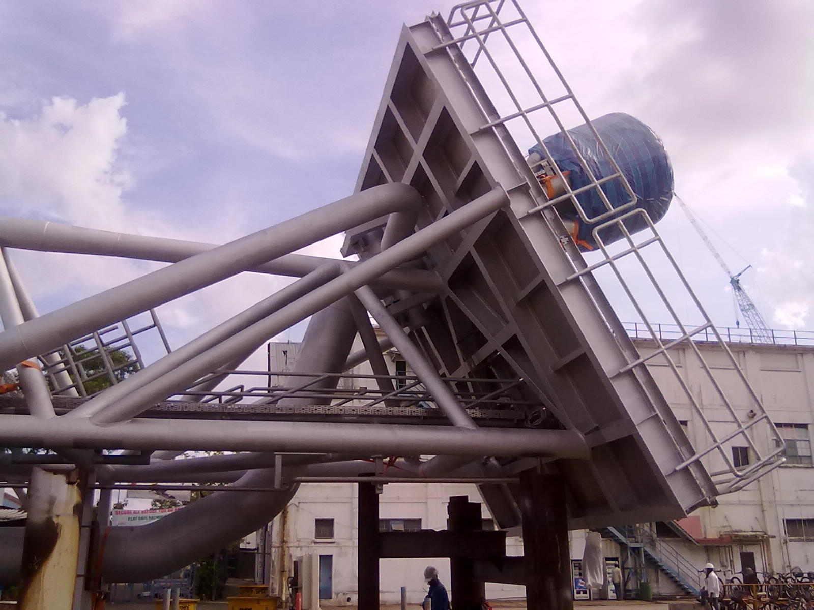
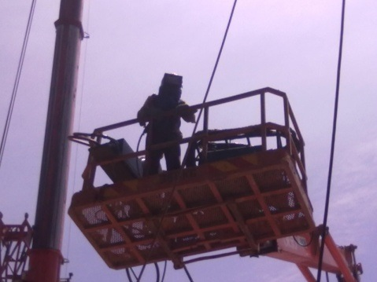
THERMAL SPRAY APPLICATIONS
Flare Towers
Caisson Pipes
Wellhead Jackets
Offshore Crane Booms
Refinery Pipelines
Heat Exchangers
Columns
Cooling Towers
Splash Zone Structures
Flue Stack
Insulated Equipment
Steel Rebars in Concrete

Slide 9
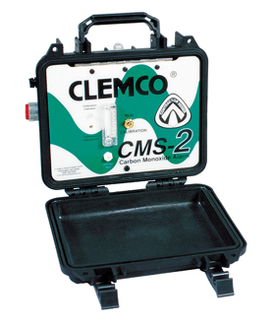
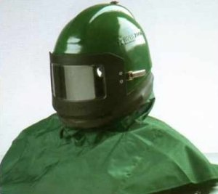
Occupational SafetY
OHSAS 18001:2007 certified Safety Management System
Inhouse Occupational Health & Safety train to all workers
Job Hazard Analysis / Risk Assessment conducted prior to every job
Immediate Preventive & Correction Action for absolute safety
Dedicated safety supervisory personnel
Safety briefing conducted every shift
Periodic review of safety documentation and practices
Appropriate safety wear provided to all workers
Fire Retardant coverall suits for TSC Applicators
Specifically designed respiratory helmets for TSC personnel
CO Monitor used to check air quality
Industry best saftey practices
Ability to work under stringent safety requirements

Slide 10
Job Hazard Analysis - JHA
Working within a Live plant poses a number of safety concerns. Based on our previous experience we have been able to identify and work around such obstacles.
Work Zone Safety
    Specific work areas will be isolated and containment setup for complete safety
    Mandatory warning singage will be displayed
    Adequate lighting and optimal air quality will be ensured
    Usage of approved / certified equipment only
    Very high work areas can be addressed using cherry pickers
Flammable / Hazardous Gases at work area
    Mandatory Gas Meter checks prior and during application
    Aluminium Wires / Paint to be stored away from work areas and clear of other trades
Abrasive Blasting Safety Concerns
    Vacuum Blasting can be used to eliminate the risk of flying debris and can be safely carried out alongside other trade
    Periodic cleaning / disposal to grit to ensure clean and safe working environment

Slide 11
Job Hazard Analysis - JHA
Thermal Spray Coating Safety Concerns
    Dust Collector / Extraction Fans to minimize the dust and aluminium fumes with periodic cleaning of the dust collector filters.
    Blowers and Fans will be installed to ensure air circulation and optimal air quality
    Appropriate PPE and Respirator Cartridges meant specifically for Aluminium fumes
    TSC Application to commence only after gas meter check and in the presence of a fire watchman
    Hard to reach areas can be application using our TSA gun extensions
Applicator Fatique
    Each Applicator to be accompanied by a helper
    Job rotation every 2 hours
    Adequate provision of hydration packs
    CO Monitor will be used throughout the operation timeline ensuring air quality
    Individual signal switches for emergency / troubleshooting
    Emergency first aid kits, product MSDS etc. readily available at site

Slide 12
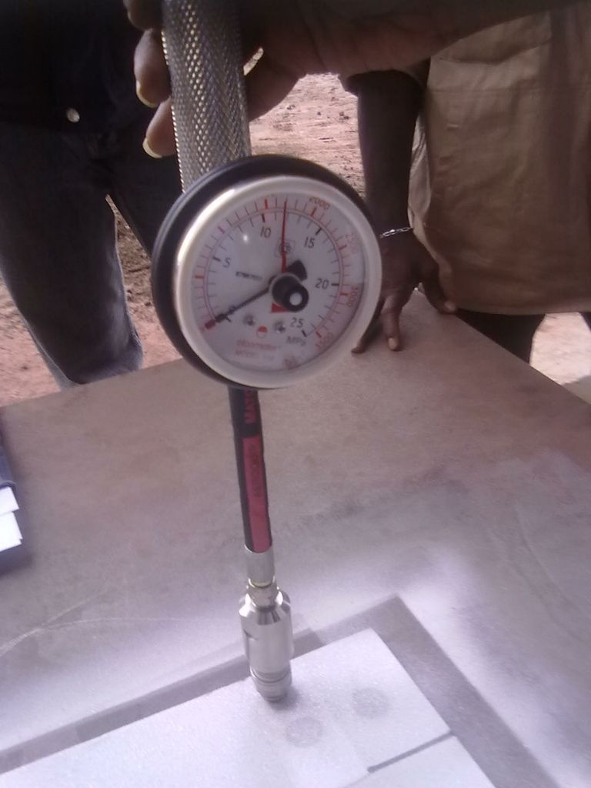
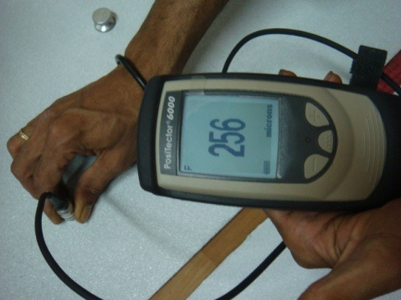
PRODUCTION QUALITY CONTROL
Conformance to NACE/SSPC/ISO/ASTM Standards or as per Client Specifications
Annual Calibration of Inspection Equipment
Coating material: Chemical Composition Test (TUV SUD lab)
Ambient and Atmospheric Conditions (continuous)
Surface preparation:
  Pre-blasting Surface Cleaning (field)
  Compressed Air Quality Test (field)
  Surface Cleanliness Test (field)
  Surface Profile Measurement (field)
  Dust Contamination Test (field)
  Chloride Level Test (field)
Coating characteristics:
  Bend Test (field)
  Coating thickness (DFT) and appearance (field)
  Adhesion Test (field)
  Porosity Test (DNV lab)
  Sealant Penetration

Slide 13
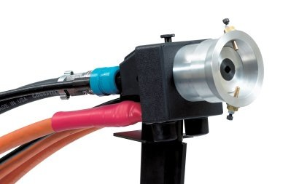
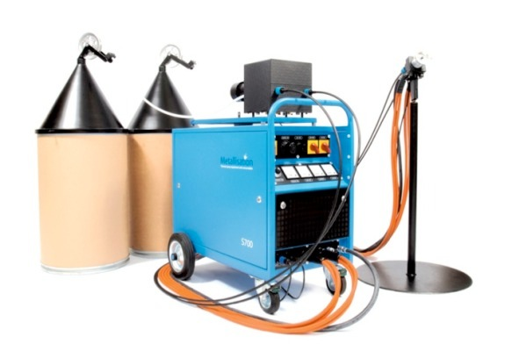
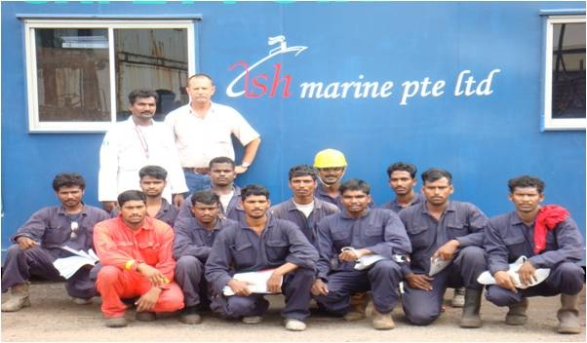
Equipment & Personnel
TSA EQUIPMENT:
  Twin-wire Arc Spray (Arcspray 701 & 140 by Metallisation Limited)
  Generation II Arc Spray by Thermion
  99.5% Grade Aluminium wires (4.8, 3.2 and 2.3mm diameters)
  Flame Spray (IMC-88)
Light-weight and fully portable equipment
Ideal for shop as well as field application in all environments
High Production Rate with excellent finish
TSA APPLICATION TEAM:
Project Leaders: NACE Level-II & III certified
Supervisors: SSPC PCI certified
Applicators: Trained and Certified

Slide 14
PROJECTS & CLIENTS
PROJECT: SHANGHAI ;CLIENT:KEPPEL SHIPYARD ; YEAR:2007
PROJECT: PETRO RIG 1,2,3 ; CLIENT:AKER KVAERNER ; YEAR:2008
PROJECT: PETRO RIG 4 ; CLIENT: AKER KVAERNER ; YEAR:2009
PROJECT: SEADRILL-13 ; CLIENT: AKER KVAERNER ; YEAR: 2009
PROJECT: SPT-SPP-2 ; CLIENT:EXXON MOBIL(APECO) ; YEAR:2009-2010
PROJECT: SPT-SPP-2 ; CLIENT:EXXON MOBIL(STK) ; YEAR:2009
PROJECT: SPT-SPP-2 ; CLIENT:EXXON MOBIL(PUNJ LLOYD) ; YEAR:2009
PROJECT: SKARV TURRET ; CLIENT:KEPPEL SHIPYARD ; YEAR:2009
PROJECT: TRESTLE MODULE ; CLIENT: HIAP SENG ; YEAR:2009
PROJECT: HALFDAN PHASE IV FPSO- FLARE TOWER ; CLIENT:MAERSK ; YEAR:2010
PROJECT: HALFDAN PHASE IV FPSO- UNDERSIDE ; CLIENT: MAERSK ; YEAR:2010
PROJECT: SPT HQSM ; CLIENT : FOSTER WHEELER,EXXON MOBIL ; 2010-2011
PROJECT: DEEN DAYAL,LUMUT,MALAYSIA-JACKET ; CLIENT:LARSEN & TOUBRO;2010-2011
PROJECT: CRANE BOOM; CLIENT: FAVELLE FAVCO,BP; YEAR:2011
PROJECT: GUMUSUT KAKAP; CLIENT: PETRONAS, SABAH SHELL; YEAR: 2011
PROJECT: HIJAU GASOIL, HEAT EXCHANGERS; CLIENT: SHELL, FLUOR; YEAR 2012
PROJECT: PIPELINE REPAIR; CLIENT: SHELL PORT DICKSON; YEAR 2012-2013
PROJECT: QUAD 204 - I-TUBES; CLIENT: DYNAMAC SHIPYARD; YEAR 2013
PROJECT: STONES TURRET - BUOY: KEPPEL SHIPYARD; YEAR 2014
PROJECT: WHEATSTONE – TOPSIDE; KENCANA; YEAR 2015
PROJECT: SK316 – FLARE TOWER & PIPES; MMHE; YEAR 2015
PROJECT: BESAR – FLARE TOWER & WELLHEAD; MMHE; YEAR 2015
PROJECT: MALIKAI – DRIVEN PILES; MMHE; YEAR 2016
PROJECT: MUMBAI HIGH SOUTH REDEVELOPMENT; KENCANA; YEAR 2016

Slide 15
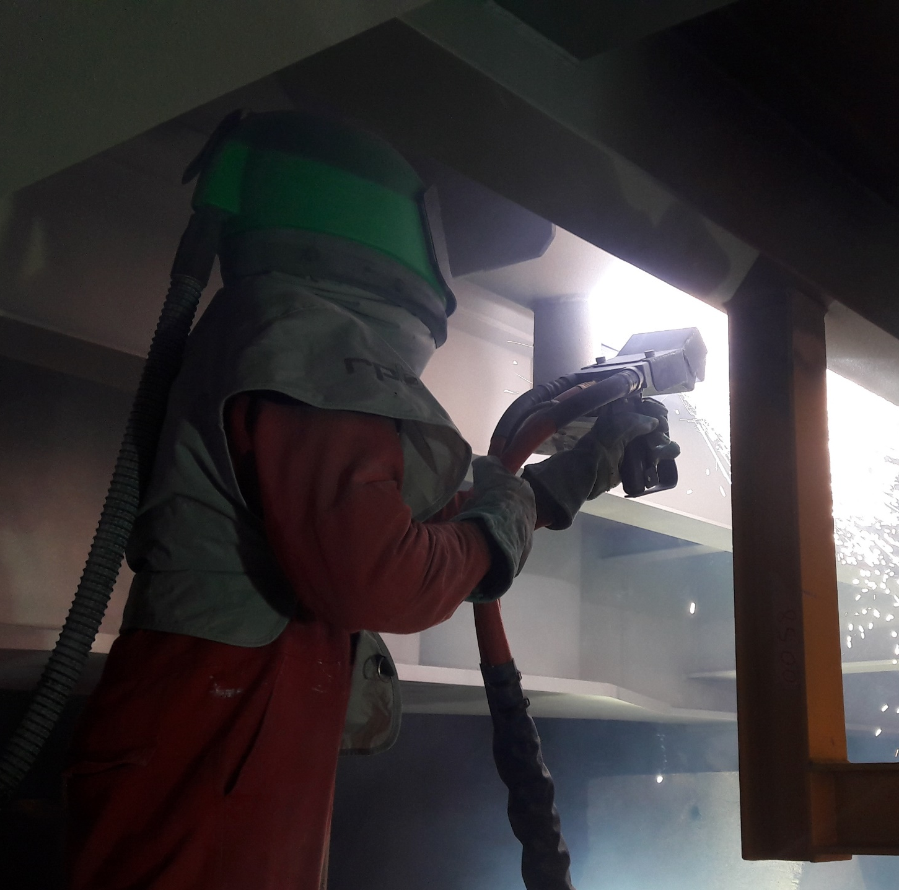
PROJECTS
MUMBAI HIGH SOUTH REDEVELOPMENT (MHSRD-III)
Project: MHSRD-III
Owners: ONGC
Client: Sapura Kencana
Area applied: 11,000m²
Structure: Cellar Decks & Jacket
Specification:
Blasting : SA3
TSA : 200µm
Sealer : Epoxy Sealer
Special efforts: Different structures for different modules were setup and run concurrently to deliver the project on fast track basis. Additional team for chamber application thoughout the project duration.

Slide 16
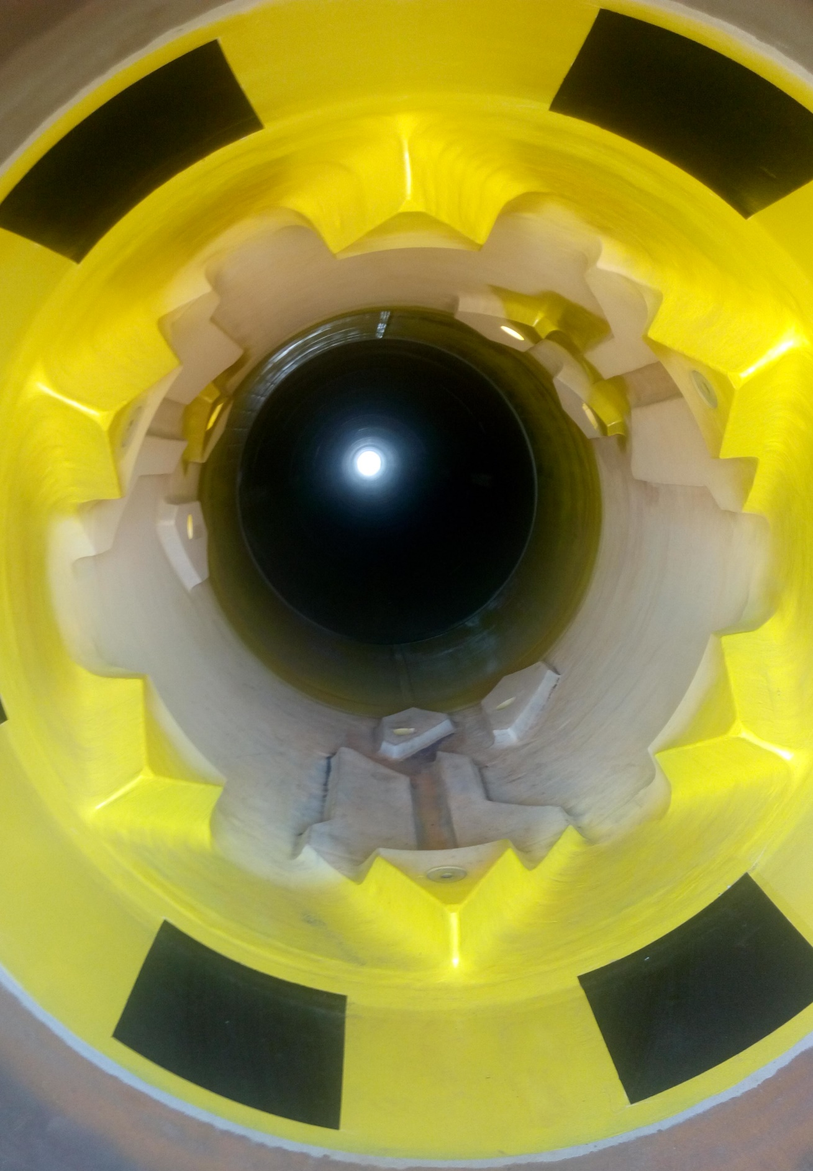
PROJECTS
MALIKAI TLP PROJECT – SHELL
Project: MALIKAI TLP PROJECT
Owners: SHELL
Client: MMHE
Area applied: 744m²
Structure: Driven Pile
Specification:
Blasting : SA3
TSA : 250µm
Sealer : Epoxy Sealer
Special efforts:The weld seams of 8 driven piles and the receptacle connectors were applied. The length of the pile posed challenges for internal application. Additional capable length and the machine were setup inside the pile itself during application.

Slide 17
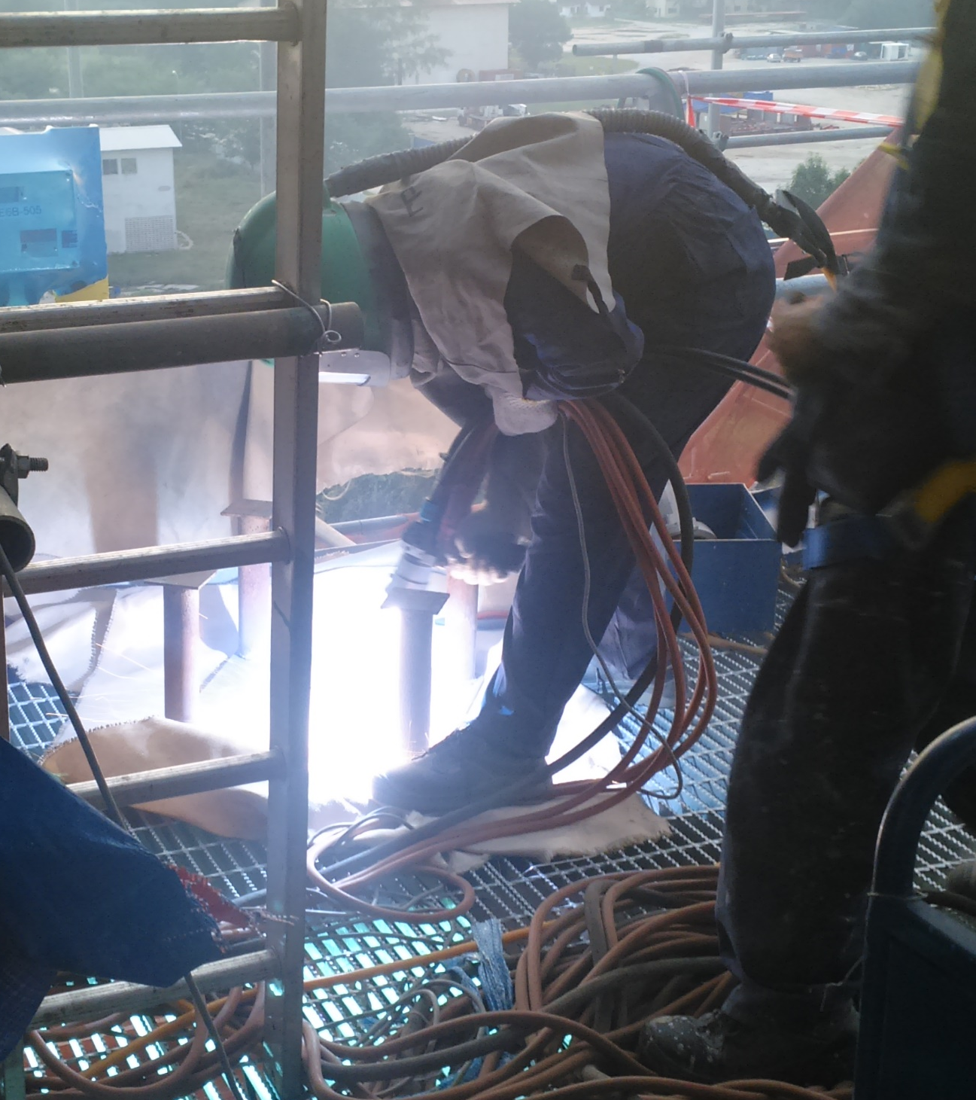
PROJECTS
WHEATSTONE - CHEVRON
Project: WHEATSTONE PROJECT
Owner: CHEVRON
Client: Sapura Kencana
Area applied: 1200m²
Structure: Modules EB101 & KB101
Specification:
Blasting : Sa 2.5
TSA : 250µm
Sealer : Silicone Aluminium
Special efforts: Machines were loaded onto the module to facilitate ease of application.

Slide 18
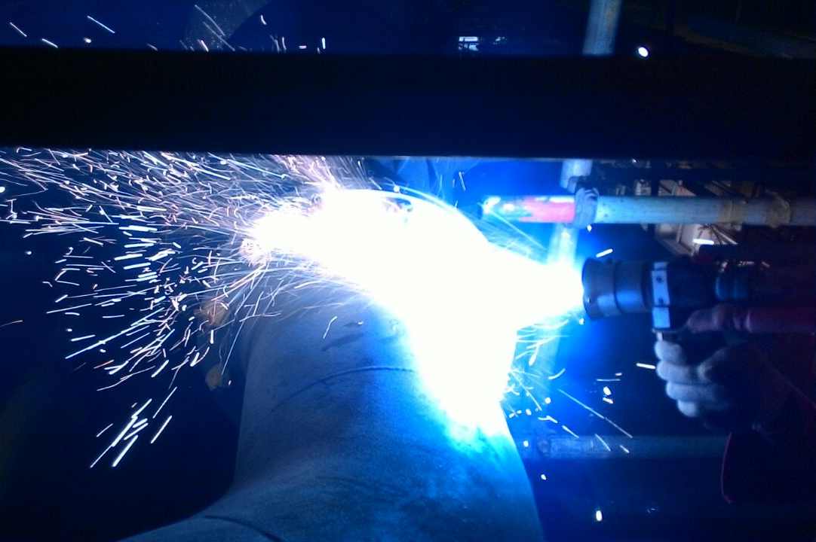
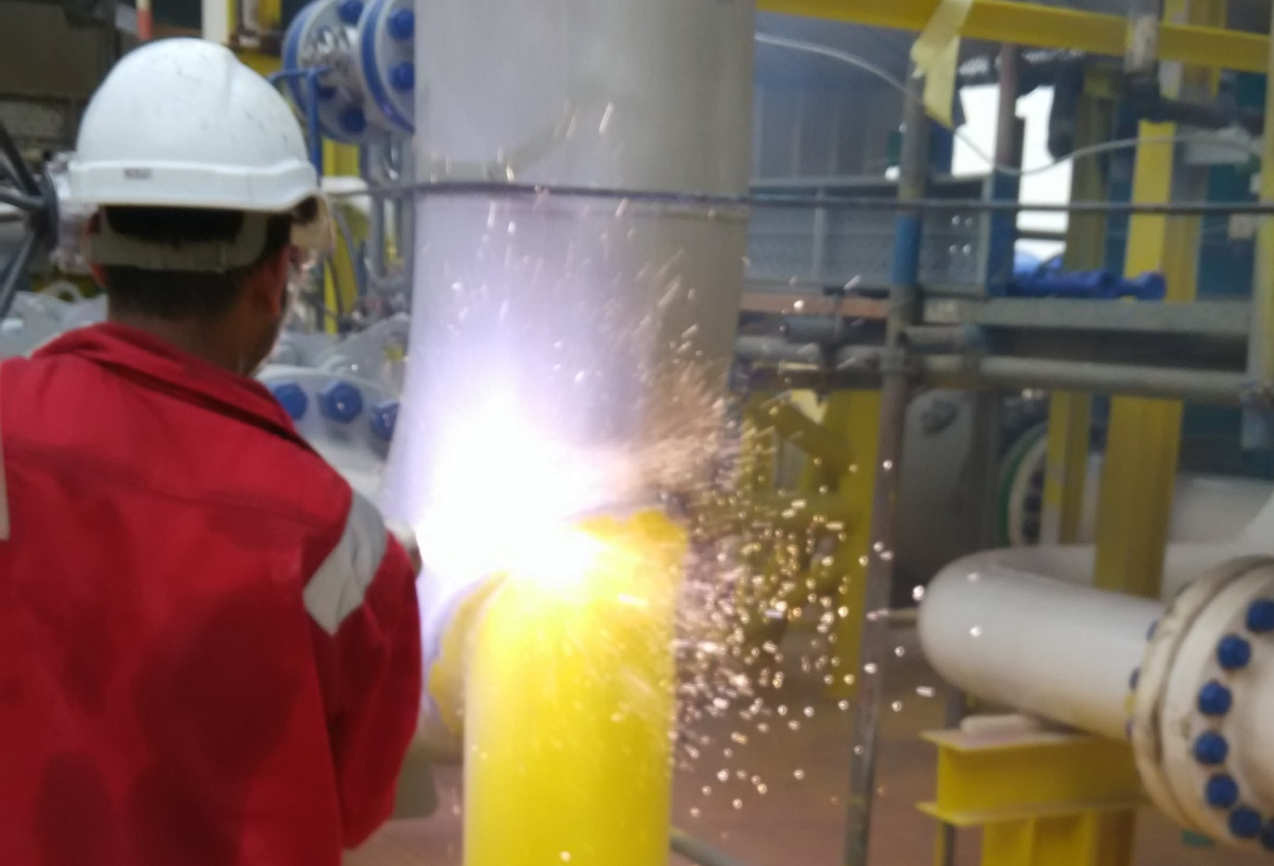
PROJECTS
SK316 - PETRONAS
Project: SK316 NC3 PROJECT
Owner: PETRONAS
Client: MMHE
Area applied: 2400m²
Structure: Flare Tower & Pipes, CPP & WHP Pipe Welds at Offshore Platform Location
Specification:
Blasting : Sa 2.5
TSA : 250µm
Sealer : Silicone Aluminium

Slide 19
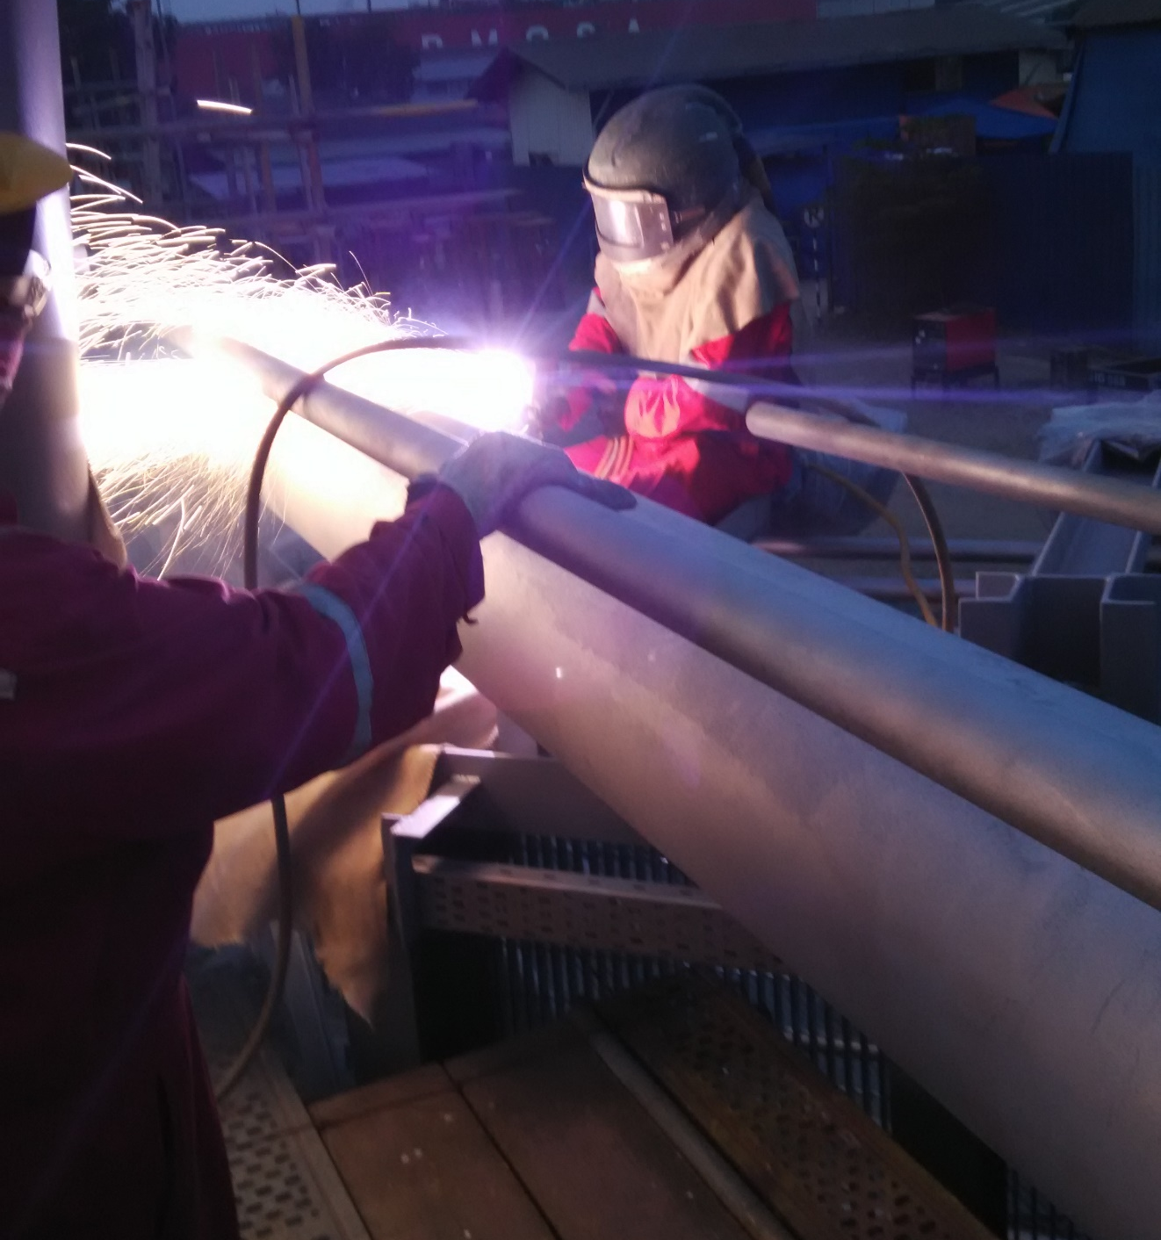
PROJECTS
BESAR - PETRONAS
Project: BESAR PROJECT
Owner: PETRONAS
Client: MMHE
Area applied: 800m²
Structure: Wellhead & Flareboom
Specification:
Blasting : Sa 2.5
TSA : 250µm
Sealer : Silicone Aluminium

Slide 20
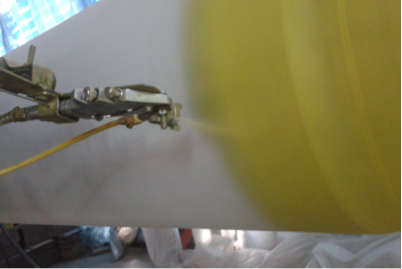
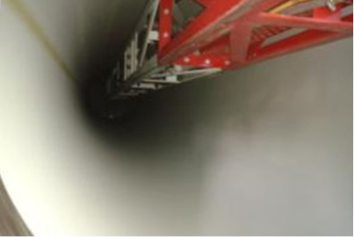
PROJECTS
Gumusut Kakap - Shell
Project: Gumusut Kakap Project
Owners: MISC (subsidiary of Petronas)
Principal: Sabah Shell Petroleum Company
Client: MMHE Malaysia
Area applied: 600m²
Structure: Seawater Caisson Pipes (internal & external surfaces)
Specification:
Blasting : SA3
TSA : 250µm
Sealer : Silicone Aluminium
Special efforts: Equipment was setup for semi-automatic application of blasting, TSA and sealer coating

Slide 21
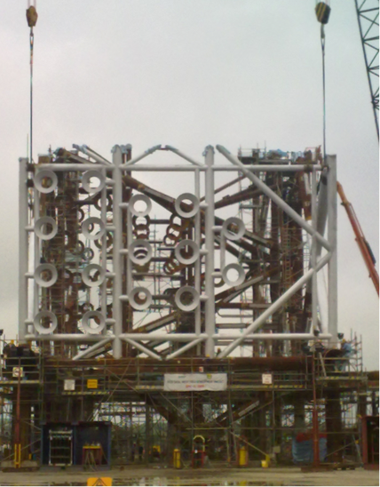
PROJECTS
Deen Dayal field development project
Project: Deen Dayal Field Development
Owners: Gujarat State Petroleum Company
Clients: Larsen & Toubro Limited
Area applied: 2500m²
Structure: Six-legged wellhead jacket
Specification:
Blasting : SA3
TSA : 250µm
Sealer : Silicone Aluminium
Special efforts: Usage of cherry picker & scaffolding at up to 30m

Slide 22
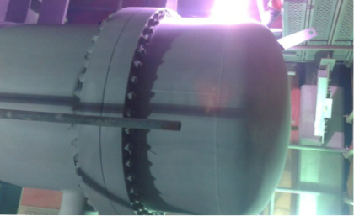
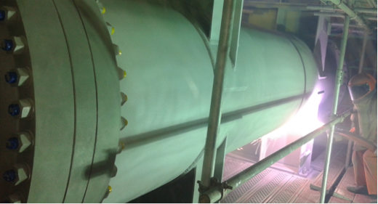
PROJECTS
Hijau GasOil - Shell
Project: Hijau GasOil Project
Owners: SHELL (Federation of Malaya)
Clients: FLUOR
Area applied: 550m²
Structure: Heat Exchangers
Specification:
Blasting : SA3
TSA : 250µm
Sealer : Silicone Aluminium
Special efforts: Work performed inside the oil refinery. Containment was setup around the exchangers to prevent dust and smoke contamination. Weather simulations were performed to detect defects and weak spots

Slide 23
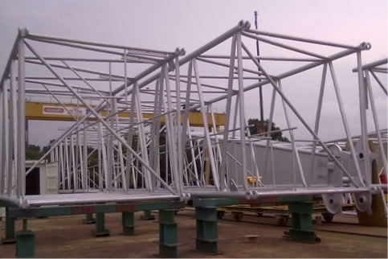
PROJECTS
BP CRANE BOOM PROJECT
Project: BP Crane Boom Project
Owners: British Petroleum
Clients: Favelle Favco Sdn Bhd
Area applied: 600m²
Structure: Crane Booms
Specification:
Blasting : SA2.5
TSA : 250µm
Sealer : Silicone Aluminium
Special efforts: The small diameter of the tubes forming the lattice proved challenging for even application which was overcome by working longer hours and synchronizing processes for minimal time loss

Slide 24
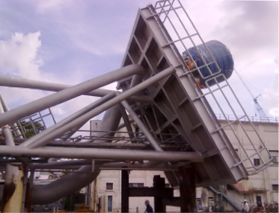
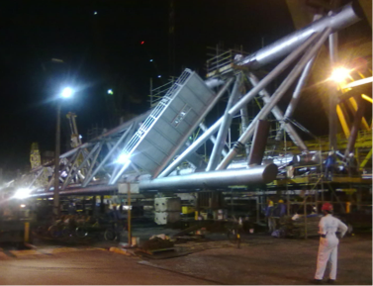
PROJECTS
Halfdan Phase IV
Project: Halfdan Phase IV Project
Owners: Maersk
Clients: SMOE
Area applied: 4000m²
Structure: Flare Tower
Specification:
Blasting : SA2.5
TSA : 250µm
Sealer : Silicone Aluminium
Special efforts: Round the clock operations (3 shifts). Encapsulation & Dehumidifier setup. Cherry picker was also used for working at various heights

Slide 25
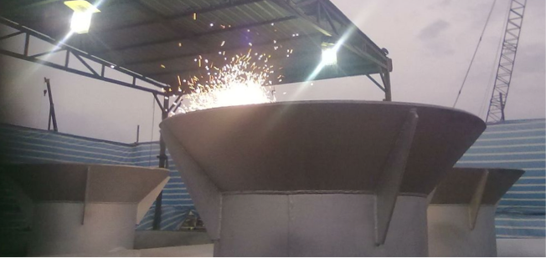
PROJECTS
SKarv Turret
Project: Skarv Turret Project
Owners: British Petroleum, SBM
Clients: Keppel Shipyard
Area applied: 500m²
Structure: I-tubes (21inches in diameter)
Specification:
Blasting : SA2.5
TSA : 250µm
Sealer : Silicone Aluminium
Special efforts: Mobility of equipment and the small diameter of the tubes posed various challenges which were overcome by effective pre-planning and quick thinking

Slide 26
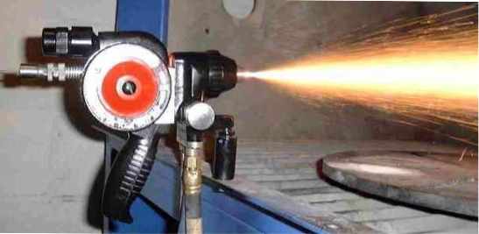
PROJECTS
SPT Project - Foster Wheeler
Project: SPT Project
Owners: Exxon Mobil
Clients: Foster Wheeler, HQSM
Area applied: 1100m²
Equipment: Flame Spray
Structure: Pipelines
Specification:
Blasting : SA3
TSA : 250µm
Sealer : Silicone Aluminium
Special efforts: High rise pipelines at heights between 30-40m. Adherence to safety procedures because work was carried out inside the oil refinery

Slide 27
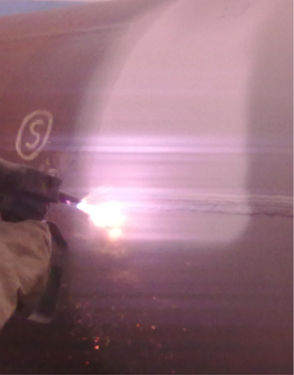
PROJECTS
SPT project - Exxon Mobil
Project: SPT Project
Owners: Exxon Mobil
Clients: Singapore Takada Industries, APECO, Punj Lloyd
Area applied: 5000m²
Structure: Pipes (4-28 inches in diameter)
Specification:
Blasting : SA2.5
TSA : 250µm
Sealer : Silicone Aluminium
Special efforts: Works were carried in the Ash Marine chambers. It was an ongoing project for a period of one year

Slide 28


Contact US
Malaysia
L10-8, Menara Sentral Vista,
150, Jalan Sultan Abdul Samad,
Brickfields, 50470, Kuala Lumpur
Tel: +603 2303 5751 / 5752
Fax: +603 2303 5669
Singapore
21 Woodlands Close
#04-23 Primz Bizhub
Singapore 737854
Tel: +65 6776 6073
Fax: +65 6776 6075
w w w . a s h m a r i n e . c o m . s g
Email: pnaren@ashmarine.com.sg

Slide 29

Make Us Your Preferred Choice For All Your Abrasive Blasting and Protective Coating Needs

